Slide 1

RESUME CLASSIFICATION
RESUME CLASSIFICATION A NLP PROJECT
Group -5

Slide 2
Mentors Group members
Snehal Shinde
B Harish
Nimisha P J
Lokesh R
NAVEEN KUMAR B
VIRESH DWIVEDI
Mohan Kumar N.C
Abhinav Gundala

Slide 3
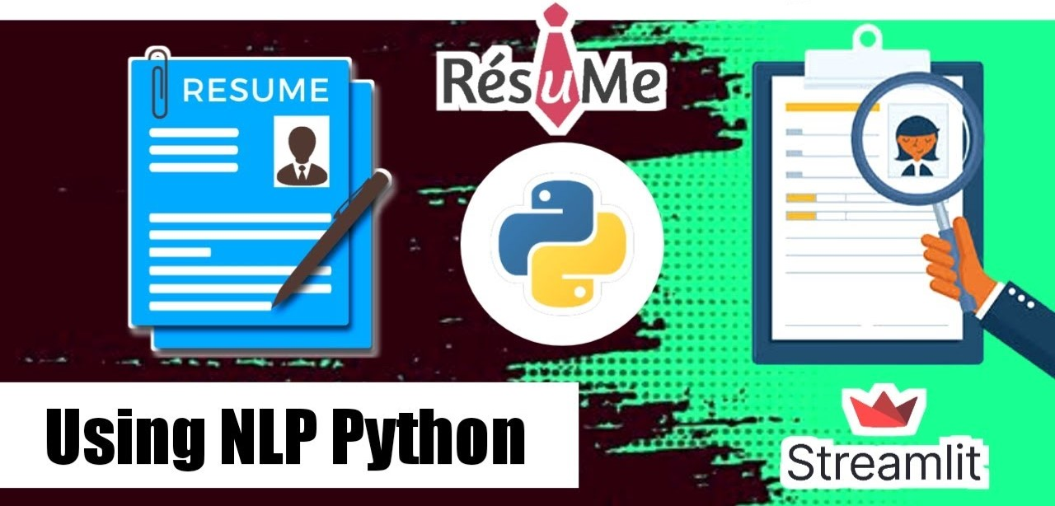

Slide 4
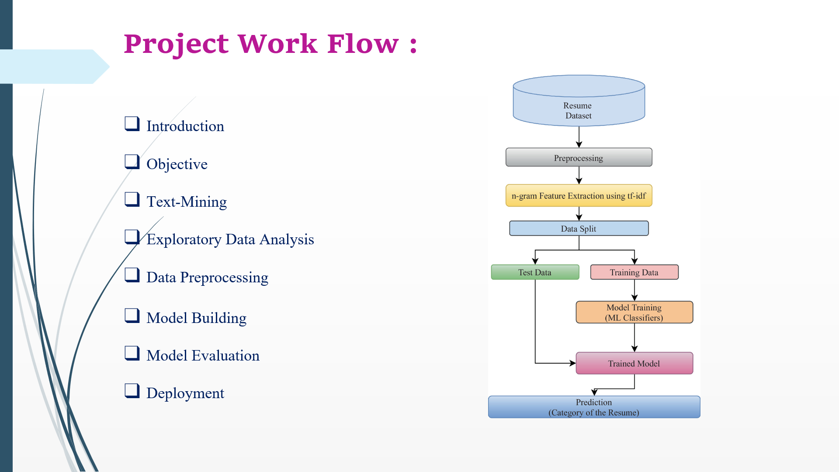

Slide 5

Business Objective
Resume classification is an essential task in modern recruitment processes, enabling organizations to efficiently filter, categorize, and rank candidate resumes based on predefined criteria. The process begins by extracting key features from resumes, such as skills, work experience, education, and certifications, using text parsing and NLP methods. Machine learning models, including supervised learning algorithms like Support Vector Machines (SVM) and Random Forests, are then employed to classify resumes into relevant categories, such as job roles, experience levels, or skill requirements

Slide 6
INTRODUCTION
Resume classification is a pivotal aspect of the recruitment process that involves automatically categorizing and sorting job applicants' resumes based on specific criteria such as skills, experience, job roles, and educational background. As organizations receive large volumes of resumes for job openings, manually reviewing each document becomes time-consuming and inefficient. To address this challenge, automated resume classification systems utilize various methods from machine learning (ML), natural language processing (NLP), and artificial intelligence (AI) to streamline the recruitment process.

Slide 7
Timeline
In this project certain tasks were carried out
Week-1 – Exploratory Data Analysis[including Business objective discussion & Data set details]
Week-2 - Model Building
Week-3 - Model Evaluation & Deployment[using Streamlit]
Week-4 – Final Presentation

Slide 8
STEPS PERFORMED
Data collection and preparation.
Text extraction and content parsing.
Feature extraction Data representation Model training
Model evaluation (using metrics like accuracy, recall).
Post-processing (shortlisting and ranking candidates).
Text preprocessing
Resume classification (applying the trained model to classify
Continuous improvement
Deployment

Slide 9
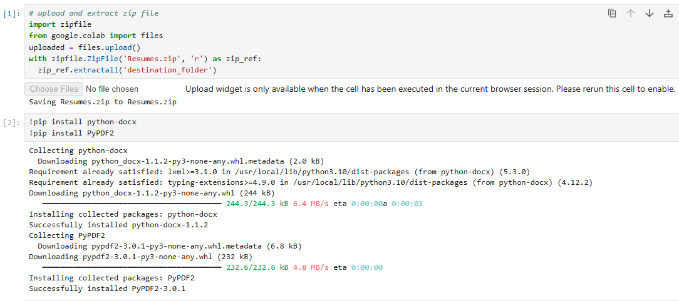
IMPORTING NECESSARY LIBRARIES

Slide 10
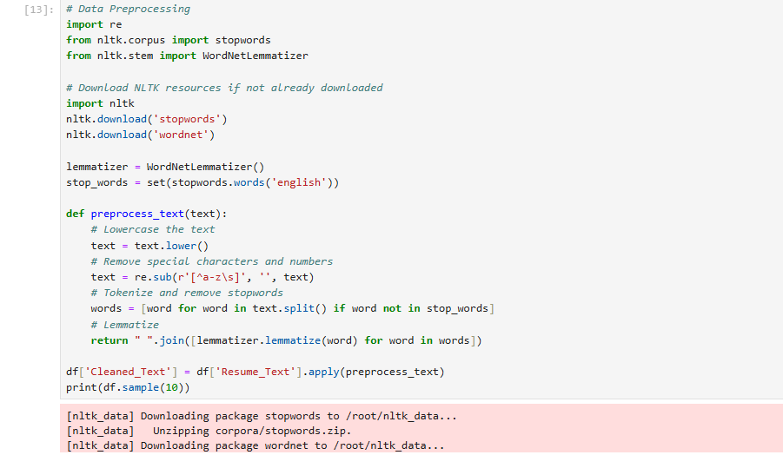

Slide 11
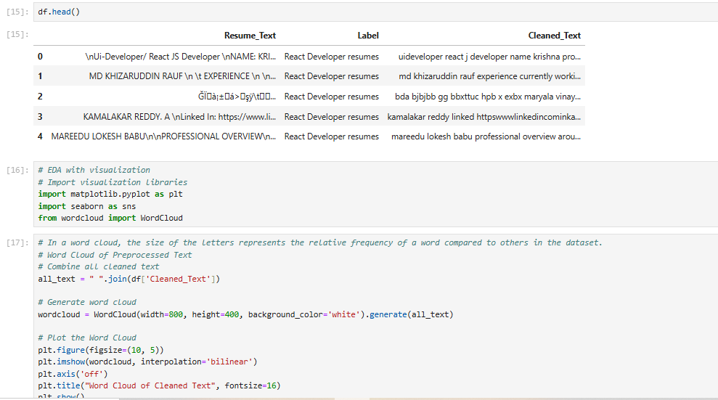

Slide 12
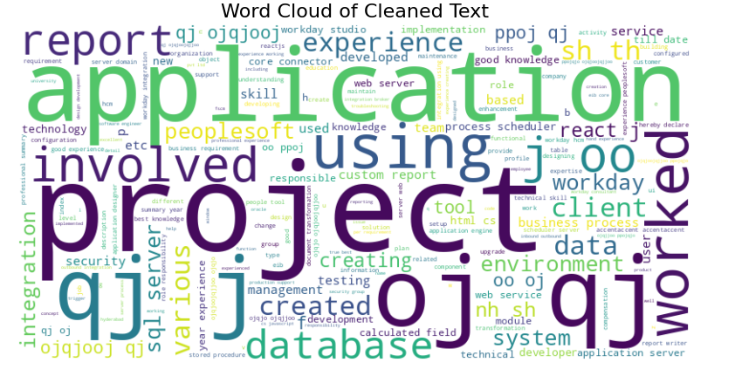

Slide 13
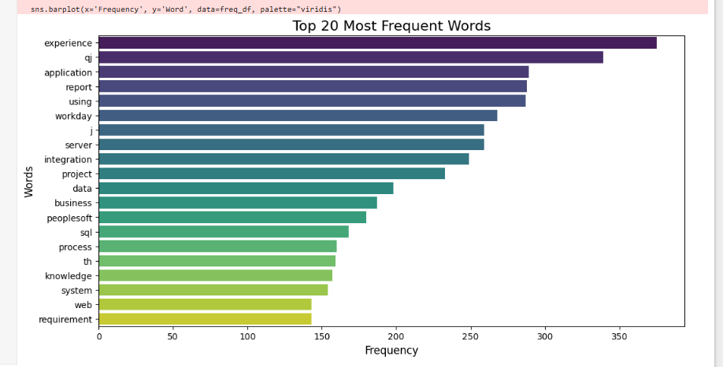
VISUALIZATION

Slide 14
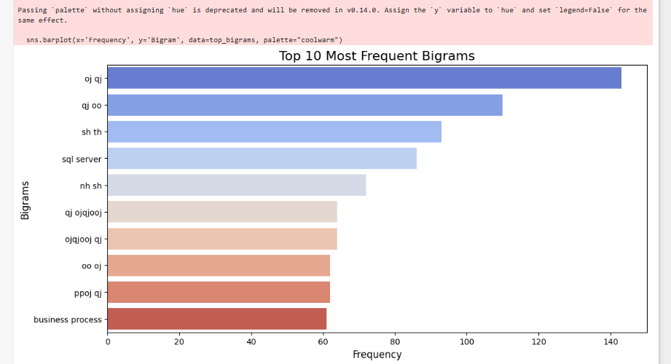

Slide 15
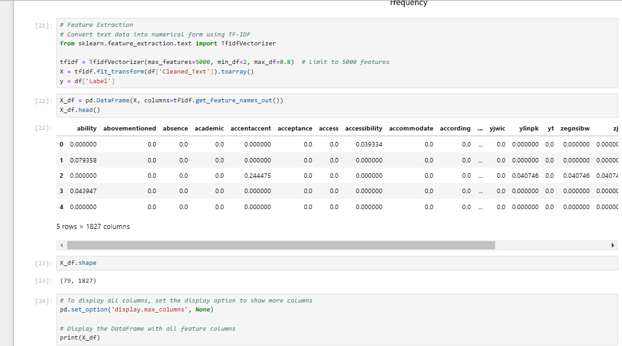
FEATURE EXTRACTION

Slide 16
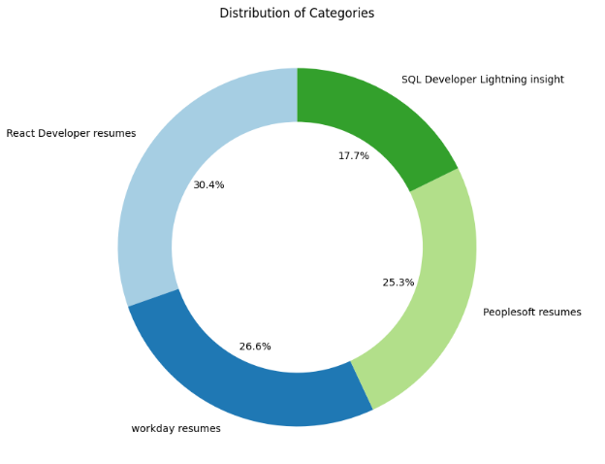

Slide 17
Comparing different types of machine-learning algorithms
K-Nearest Neighbors
Decision Tree
Random Forest
Support Vector Machine
Logistic Regression
Bagging Classifier
Ada Boost Classifier
Gradient Boosting
Naive Bayes

Slide 18
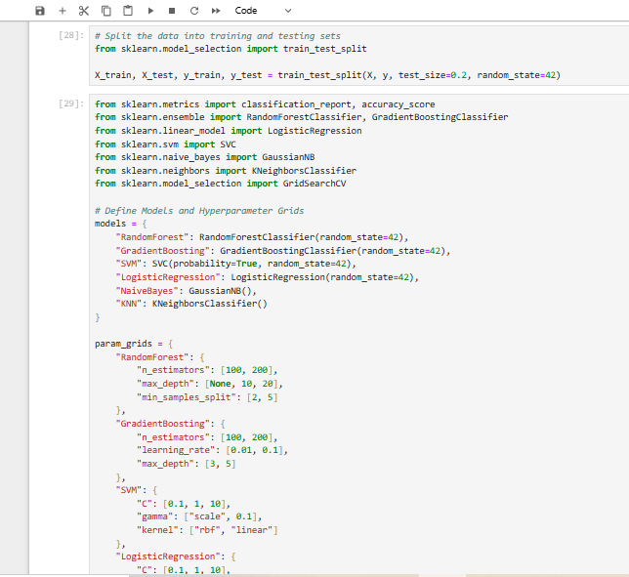
MODEL EVALUATION

Slide 19
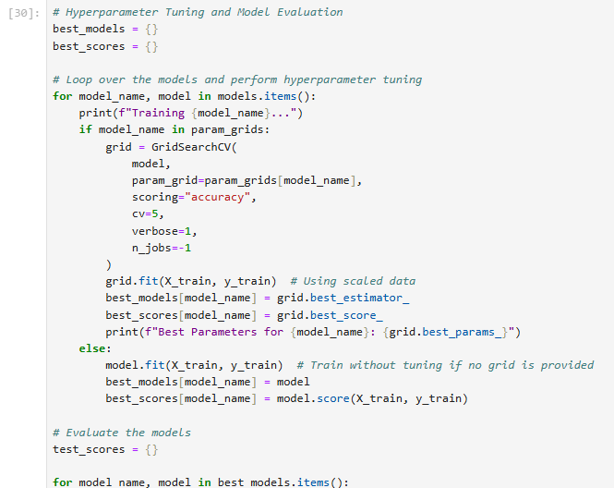

Slide 20
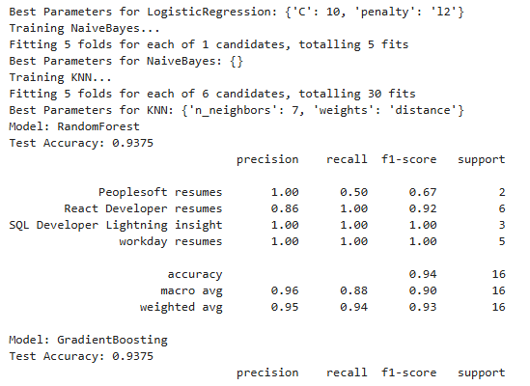

Slide 21
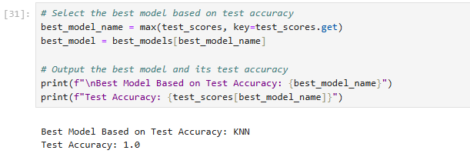
TEST ACCURACY

Slide 22
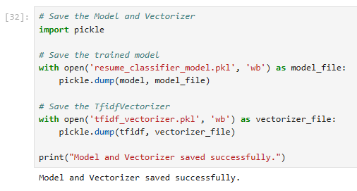
PICKLE FILE

Slide 23
Deployment
To complete the deployment, we used Streamlit cloud
We have rendered the deployment use the GitHub
Scalability and load balancing
Ensure that the model has been thoroughly evaluated with appropriate metrics (e.g., accuracy, precision, recall, F1-score) on the test set and is performing well.
Pickle or Joblib for Python-based models.
Set Up a Deployment Environment

Slide 24
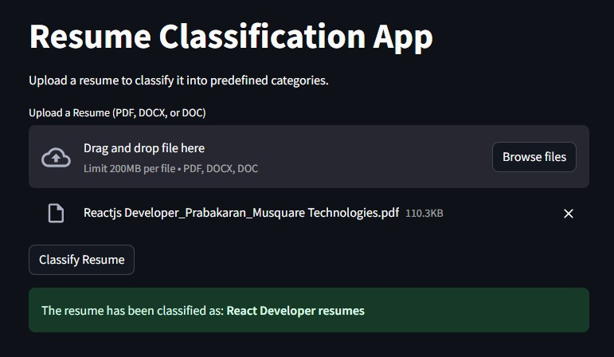
Final Output

Slide 25
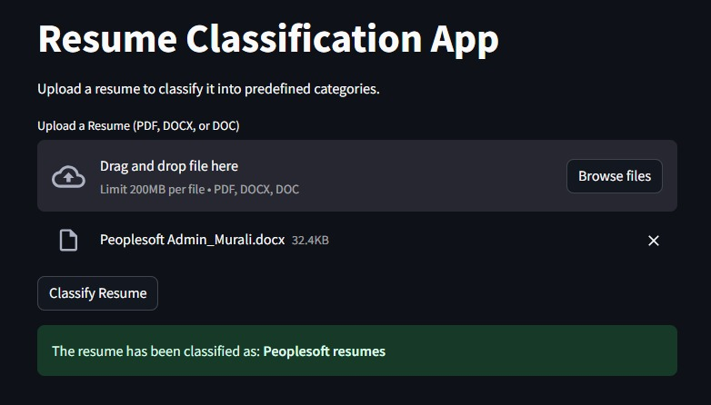

Slide 26
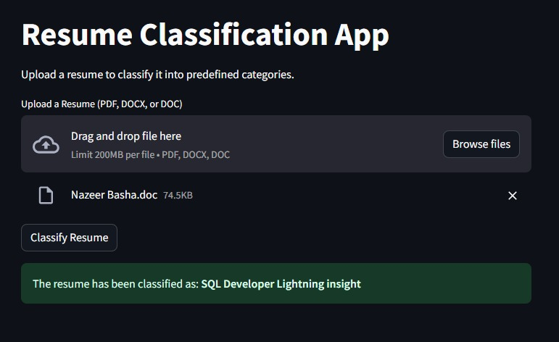

Slide 27
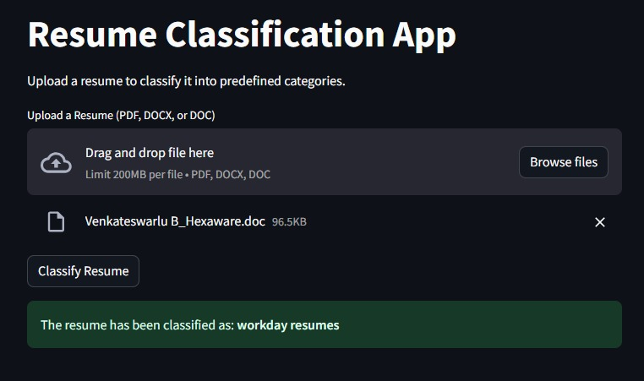

Slide 28
Difficulties
As new job skills and qualification emerges the model needs to be periodically retained with updated data.
SYSTEM MAINTEINANCE AND DOWNTIME
USER ADOPTION AND TRUST

Slide 29
Future Enhancement
We have compared the various state of the art algorithms using similar self-generated data which allowed us to compare them in an unbiased way.
Data was raw and it had more deformities, so we had to clean it up various times.
This will provide potential candidate to the organization and the candidate will be successfully be placed in an organization which appreciate his/her skillset and ability
Companies will be benefitted by using this project .

Slide 30
Conclusion
The future of resume classification is set to revolutionize the hiring process by leveraging advanced AI and NLP techniques to provide more accurate, fair, and personalized recruitment solutions. Key developments like bias reduction, multimodal analysis, personalized job matching, and seamless integration with other HR systems will transform how organizations attract and evaluate talent. At the same time, AI will continue to provide candidates with personalized feedback and career guidance, leading to more efficient and inclusive hiring practices.

Slide 31


